Slide 1
Applications of AI for Predictive Maintenance

Slide 2
The Learning Platform
The Team
Workshop Perspective
Introduction to Predictive Maintenance
The XGBoost Algorithm
Methodology
Model Accuracy
AGENDA
Notes:
Here is the agenda for this lab. We will first introduce the learning platform, the team, and the workshop perspective. We will then discuss some background concept on Predictive Maintenance. This first lab will focus on using the XGBoost algorithm for failure classification. As such, we will discuss the methodology for XGBoost as well as how to measure model performance.

Slide 3
WORKSHOP perspective

Slide 4
WORKSHOP SUMMARY
Full-day workshop with hands-on labs
Applications of different types of deep learning models across data collection, curation, and formatting, based on a real production dataset (Backblaze hard disk DB)
The workshop covers a variety of methods/algorithms from Tree-based Machine Learning approaches to Deep Learning models.
You’ll learn how to deal with false/true positives in industrial applications by utilizing different methods such as time series prediction and anomaly detection.
Notes:
This is a full-day workshop with hands-on labs. We will learn about various models in the context of Predictive Maintenance, ranging from Tree-based models to deep neural networks for classification, time series prediction, as well as anomaly detection.

Slide 5
WORKSHOP OUTLINE
1
LAB 1 (2 hrs)
Training GPU XGBoost Models with RAPIDS for Time Series
2
LAB 2 (2 hrs)
Training GPU LSTM Models Using Keras + Tensorflow for Time Series
3
LAB 3 (2 hrs)
Training Autoencoder for Anomaly Detection
Notes:
The workshop is broken down into three parts, each covering a different model for failure classification, time series prediction, and anomaly detection.

Slide 6
Introduction To Predictive Maintenance

Slide 7
PREDICTIVE MAINTENANCE
Schedule-based maintenance provides a regularly scheduled time for part replacements and repairs. A more efficient approach is predictive maintenance: part replacements are driven by data and analytics.
Predictive maintenance can be divided into several key steps : a) estimation of remaining useful life of critical parts, b) identification of anomalies, c) mapping of anomalies to part failures through service logs.
Predictive maintenance helps to manage failures and avoid costly unplanned downtime.
Other benefits include fewer unnecessary repairs, optimized spare parts inventory, and longer lifespan of equipment and parts—ultimately increasing equipment availability and improving operational efficiency.
Notes:
A common practice in maintenance is to perform replacements and repairs at regular schedule times. While effective, it doesn’t catch all failures and can lead to costly unplanned downtime. A more efficient approach is to perform predictive maintenance based on data and analytics. This can help to better manage failures, avoid unnecessary repairs, optimize spare parts inventory, and yield longer lifespan of equipment and parts. Predictive maintenance can be divided into several key steps:
estimation of remaining useful life of critical parts
Identification of anomalies
Mapping of anomalies to part failures through service logs

Slide 8
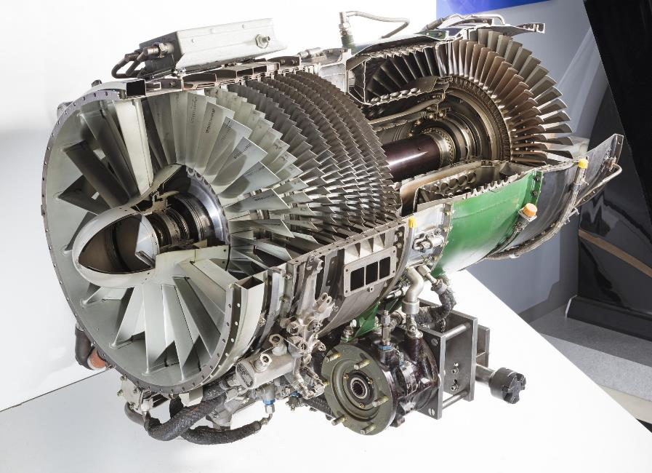
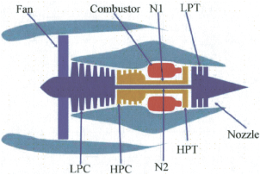

REMAINING USEFUL LIFE PREDICTION
Reliably predicting the remaining life of mechanical equipment avoids unscheduled maintenance and extends equipment utility.
The health of an engine fleet can be modeled using data from 21 engine sensors (temperature, pressure, rpm, etc.).
State of the art deep learning models are proving capable of predicting the remaining useful life with 35-49% better accuracy than traditional methods.
NASA engine dataset: Turbofan Engine Degradation Simulation Data Set https://ti.arc.nasa.gov/tech/dash/groups/pcoe/prognostic-data-repository/
Notes:
In a case study done for NASA’s Turbofan Engine using simulation data, using deep learning-based analytics can predict remaining useful life with 35-49% better accuracy than traditional methods.

Slide 9

Oil field Predictive Maintenance
60K Oil Wells WW equipped with Electric Submersible Pumps (ESP)
Average Non-Producing Time (NPT) due to ESP Failure costs > $150K per day per well
ML techniques used historically (rule-based, fuzzy logic, traditional ML), but they don’t scale
>50% False Alarms + detect failures too late
Deep Learning: 93% detection accuracy with 2 months lead time at 7% False Alarm (for 200 wells)
At 10% False Positive, DL-based Anomaly Detection yields $300K per well of lost productivity annually
Notes:
As another example, we calculated the potential benefits of using DL-based anomaly detection for the oil industry. Using current techniques for predictive maintenance, we experience $9Bn daily loss in production (or 150K per day per well) due to non-producing time (NPTY) from Electric Submersible Pumps (EPS). This is due to high (50%) false alarms as well as detecting failures too late to avoid NPT.
This is derived from using 60K oil wells WW using ESP, multiplied by 2500 barrels per day per well, multiplied by $60 per barrel (60000 * 2500 * $60 = $9Bn)
Using DL techniques, we tested on 200 well data obtained over 2 years, it show a 93% detection accuracy with 2 months lead time at 7% false alarm. This is a significant improvement from the current process. For comparison, at 10% False Positive, we calculated ~$300K per well per YEAR.
-=====notes from before=====-
200 well data obtained over 2 years, shows reduction in FA to 7% , detection accuracy of 97% with a lead time of 2 months.
150+ well data obtained over 2 years, shows DL techniques reduces the False Positive to <10% and achieves detection accuracy of 93% with a lead time of up to 2 months.
or cope well with the field variability (machine types, modes, age, environmental condition) and often results in > 50% False Alarms and poor anomaly detection, often too late to avoid NPT
21 days = $200 B WW 60K ESP wells. Average 2500 barrels/day/well $60 per barrel $ 9,000,000,000 per day ww production $ 150,000 per day per well $ 3,150,000

Slide 10
WHAT DOES THIS WORKSHOP COVER?
Data collection, curation, augmentation, defining performance metrics, training, inferencing, and iterating the whole pipeline to improve performance
Data curation covers processing raw dataset into Pandas Dataframe, balancing heavily imbalanced dataset, data augmentation, and labeling introduction
Several Deep Learning models, e.g. : Autoencoders and LSTMs to tackle different aspect of data analysis
Directions on how to translate data into different categories of deep learning models. Learn how turn data in a classification problem vs. how to approach it from the anomaly detection point of view
How to use cuDF to increase performance of your models
Notes:
This workshop covers data collection, curation, augmentation, model development, performance metrics, and inferencing. We start by learning to pre-process raw dataset and various data curation techniques. As mentioned before, we’ll explore several machine learning models to tackle different aspects of predictive maintenance. We will also introduce cuDF, which is an alternative to Pandas for when working with large datasets.

Slide 11
workshop structure
LAB 1 (2 hrs.)
LAB 2 (2 hrs.)
Training GPU XGBoost models with RAPIDS for Time Series
Training GPU LSTM models using Keras+Tensorflow for Time Series
Discuss predictive maintenance, Blackblaze hard drive data, challenges of dealing with large noisy datasets.
Scope into short-term ML automation problem.
Ingest raw real dataset from GPU production line for XGBoost model.
Format DataFrames and into DMatrices to fit into model.
Analyze dataset statistics (i.e. false positives, true positives.)
Examine XGBoost performance over the model.
Learn how to balance imbalanced data and measure relevant KPIs to assess the model.
Discuss Recurrent Networks and Long Short-Term Memory (LSTMs).
Learn how to mitigate Vanishing Gradient Problem using LSTMs and get familiarized with their cell structure.
Learn how to create sequences of data to feed the temporal nature of RNNs.
Design different RNN architectures and even create your own model.
Learn how to create the confusion matrix and adjust the threshold to different f-1 scores.
LAB 3 (2 hrs.)
Training Autoencoder for Anomaly Detection
Focus on a different deep learning technique, which is called anomaly detection.
Learn how to use unsupervised learning algorithms like a deep autoencoder network to perform anomaly detection.
Learn how to create different autoencoder models in Keras.
General discussion on hyperparameter tuning and threshold settings.
Notes:
The workshop is appropriately broken down into 3 labs:
In the first lab, we’ll train an XGBoost model for failure classification. We will discuss the XGBoost model as model evaluation metrics.
In the second lab, we’ll train LSTM models for time series prediction. We will discuss RNN and LSTM models, as well as the Vanishing Gradient Problem. Furthermore, we’ll experiment with different RNN architectures.
In the third lab, we’ll train an Autoencoder for anomaly detection. We will discuss a deep autoencoder networks and perform hyperparameter tuning as well as threshold setting.

Slide 12
XGBoost algorithm

Slide 13
WHAT IS XGBOOST
XGBoost stands for eXtreme Gradient Boosting
Widely known today as a "go to" model when working with structured data
Large number of XGBoost-based winning entries of Kaggle competitions
Based on tree ensemble methods such as Random Forests
XGBoost is used for supervised learning problems, where we use the training data (with multiple features) x to predict a target variable y
The actual mechanism is discussed next
Notes:
XGBoost, which stands for Extreme Gradient Boosting, is a scalable, distributed gradient-boosted decision tree (GBDT) machine learning library. It provides parallel tree boosting and is the leading machine learning library for regression, classification, and ranking problems. It’s vital to an understanding of XGBoost to first grasp the machine learning concepts and algorithms that XGBoost builds upon: supervised machine learning, decision trees, ensemble learning, and gradient boosting.
Supervised machine learning uses algorithms to train a model to find patterns in a dataset with labels and features and then uses the trained model to predict the labels on a new dataset’s features.

Slide 14
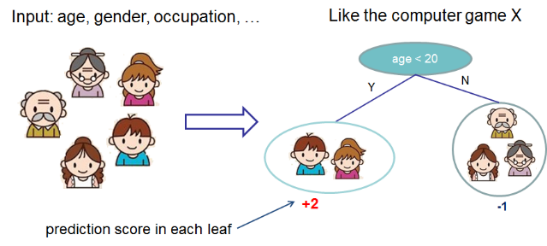
XGBoost – Classification trees
Decision trees
Image credit: XGBoost: A Scalable Tree Boosting System, T. Chen and C. Guestri
Notes:
Decision trees create a model that predicts the label by evaluating a tree of if-then-else true/false feature questions, and estimating the minimum number of questions needed to assess the probability of making a correct decision. Decision trees can be used for classification to predict a category, or regression to predict a continuous numeric value. A Gradient Boosting Decision Trees (GBDT) is a decision tree ensemble learning algorithm similar to random forest, for classification and regression.

Slide 15
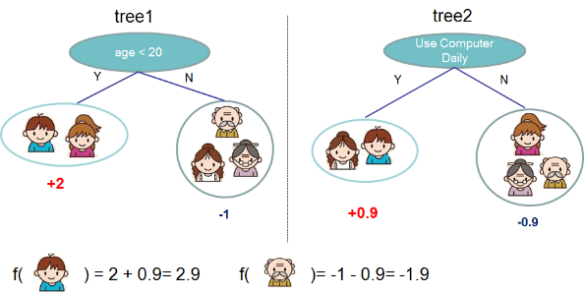
XGBoost – Classification trees
Decision tree ensembles
Tree ensemble of two trees. The prediction scores of each individual tree are summed up to get the final score
Image credit: XGBoost: A Scalable Tree Boosting System, T. Chen and C. Guestri
Notes:
Ensemble learning algorithms combine multiple machine learning algorithms to obtain a better model. Both random forest and GBDT build a model consisting of multiple decision trees. The difference is in how the trees are built and combined. Random forest uses a technique called bagging to build full decision trees in parallel from random bootstrap samples of the data set. The final prediction is an average of all of the decision tree predictions.

Slide 16
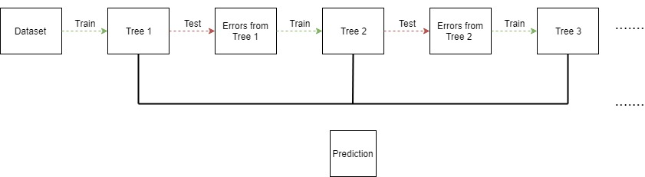
XGBoost – Classification trees
Decision trees
Repeatedly build new models and combine them into an ensemble. Unlike Random Forests, we build trees one at a time, where each new tree helps to correct errors made by previously trained tree
Notes:
The term “gradient boosting” comes from the idea of “boosting” or improving a single weak model by combining it with a number of other weak models in order to generate a collectively strong model. Gradient boosting is an extension of boosting where the process of additively generating weak models is formalized as a gradient descent algorithm over an objective function. Gradient boosting sets targeted outcomes for the next model in an effort to minimize errors. Targeted outcomes for each case are based on the gradient of the error (hence the name gradient boosting) with respect to the prediction. GBDTs iteratively train an ensemble of shallow decision trees, with each iteration using the error residuals of the previous model to fit the next model. The final prediction is a weighted sum of all of the tree predictions. Random forest “bagging” minimizes the variance and overfitting, while GBDT “boosting” minimizes the bias and underfitting.
XGBoost is a scalable and highly accurate implementation of gradient boosting that pushes the limits of computing power for boosted tree algorithms, being built largely for energizing machine learning model performance and computational speed. With XGBoost, trees are built in parallel, instead of sequentially like GBDT. It follows a level-wise strategy, scanning across gradient values and using these partial sums to evaluate the quality of splits at every possible split in the training set.

Slide 17
The Backblaze dataset

Slide 18
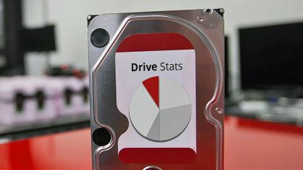
THE BACKBLAZE DATASET
“Each day in the Backblaze data center, a snapshot of each operational hard drive is taken. This snapshot includes basic drive information along with the S.M.A.R.T. statistics reported by that drive. The daily snapshot of one drive is one record or row of data. All of the drive snapshots for a given day are collected into a file consisting of a row for each active hard drive”
Image credit: Blackblaze website
Notes:
We will be using data from Backblaze data center, which includes basic drive information as well as S.M.A.R.T. statistics.

Slide 19
THE BACKBLAZE DATA FORMAT
https://www.backblaze.com/b2/hard-drive-test-data.html
Date – The date of the file in yyyy-mm-dd format.
Serial Number – The manufacturer-assigned serial number of the drive.
Model – The manufacturer-assigned model number of the drive.
Capacity – The drive capacity in bytes.
Failure – Contains a “0” if the drive is OK. Contains a “1” if this is the last day the drive was operational before failing.
2015-2017 SMART Stats – 90 columns of data, that are the Raw and Normalized values for 45 different SMART stats as reported by the given drive. Each value is the number reported by the drive.
Notes:
The daily snapshot of one drive is one record or row of data. All of the drive snapshots for a given day are collected into a file consisting of a row for each active hard drive. Each row consists of basic information such as date, serial number, model, capacity, failure (target), as well as 90 columns of S.M.A.R.T. stats.

Slide 20
DATA PREPARATION THOUGHTS
https://www.backblaze.com/b2/hard-drive-test-data.html
Successful model creation is very dependent on data quality
Time Series sensor data is notoriously ‘jittery’ and has ‘holes’
While we walk through some of the preparation, for Lab 3, we filled in the holes to ensure similar time length sequences using a ‘Forward Fill’ technique
Notes:
A high-performing machine learning model is largely dependent on data quality. As you’ll come to see, time series data can be ‘jittery’ or has ‘holes’. We will learn about data curation throughout the workshop. Specifically, in Lab 3 we’ll perform ‘fill forward’ to prepare the data for model consumption.

Slide 21
Methodology

Slide 22
Exercise
Train XGBoost on CPUs using Pandas’ DataFrame
Train XGBoost on GPUs using Pandas’ DataFrame
Train XGBoost on GPUs using RAPIDS’ cuDF

Slide 23
WHAT IS RAPIDS CUDF?
The RAPIDS suite of open source software libraries aim to enable execution of end-to-end data science and analytics pipelines entirely on GPUs. RAPIDS uses NVIDIA CUDA primitives for low-level compute optimization and is exposed to GPU parallelism and high-bandwidth memory speed through user-friendly Python interfaces.
Built based on the Apache Arrow columnar memory format, cuDF is a GPU DataFrame library for loading, joining, aggregating, filtering, and otherwise manipulating data. cuDF provides a pandas-like API that will be familiar to data engineers & data scientists, so they can use it to easily accelerate their workflows without going into the details of CUDA programming.
Notes:
cuDF is a Python-based GPU DataFrame library for working with data including loading, joining, aggregating, and filtering data. The move to GPU allows for massive acceleration due to the many more cores GPUs have over CPUs. cuDF’s API is a mirror of Pandas’s and in most cases can be used as a direct replacement. This makes it very easy for Data Scientists, Analysts, and Engineers to integrate it into their workflow. All that needs to be done is to convert your Pandas DataFrame into a cuDF one and voila you have GPU speedup! cuDF will support most of the common DataFrame operations that Pandas does, so much of the regular Pandas code can be accelerated without much effort.

Slide 24
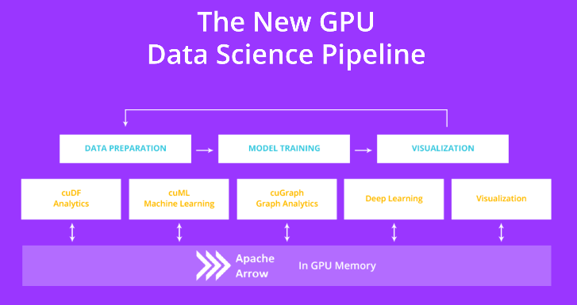
WHAT IS RAPIDS CUDF?
Notes:
The RAPIDS suite of open source software libraries and APIs gives you the ability to execute end-to-end data science and analytics pipelines entirely on GPUs. Licensed under Apache 2.0, RAPIDS is incubated by NVIDIA® based on extensive hardware and data science experience. RAPIDS utilizes NVIDIA CUDA® primitives for low-level compute optimization, and exposes GPU parallelism and high-bandwidth memory speed through user-friendly Python interfaces. RAPIDS also focuses on common data preparation tasks for analytics and data science. This includes a familiar dataframe API via cuDF that integrates with a variety of machine learning algorithms for end-to-end pipeline accelerations without paying typical serialization costs. RAPIDS also includes support for multi-node, multi-GPU deployments, enabling vastly accelerated processing and training on much larger dataset sizes.

Slide 25
Model Accuracy

Slide 26
HOW TO MEASURE MODEL ACCURACY
Accuracy rate provides us with an overview of how well our model is performing:
True Positive (TP): test correctly classifies the input as its true class (hard drive failed, and we classified it as fail)
False Positive (FP): test incorrectly classifies the input as a different class (hard drive is normal, but we classified it as fail)
False Negative (FN): test incorrectly misses to classify the input as the true class (hard drive failed but we classified as normal)
True Negative (TN): test correctly misses to classify the input to the class (hard drive is normal, and we classified as normal)
We need more insights into the accuracy. Especially, since our dataset is imbalanced, and we need to compromise some aspects of accuracy rate in favor of others
Notes:
When performing classification predictions, there's four types of outcomes that could occur.
True positives are when you predict an observation belongs to a class and it actually does belong to that class.
True negatives are when you predict an observation does not belong to a class and it actually does not belong to that class.
False positives occur when you predict an observation belongs to a class when in reality it does not.
False negatives occur when you predict an observation does not belong to a class when in fact it does.
These four outcomes are often plotted on a confusion matrix. This confusion matrix is an example for the case of binary classification. Often we need more insights into accuracy, especially if the dataset is imbalanced.

Slide 27
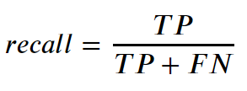
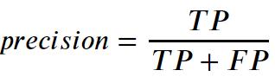
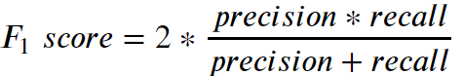
HOW TO MEASURE MODEL ACCURACY
Recall is the ability of the model to identify all true positive samples of the dataset
The ability of the model to identify the relevant samples only
F1 Score is generally considered a better overall measurement than accuracy when an uneven class distribution exists
Notes:
Precision is defined as the fraction of relevant examples (true positives) among all of the examples which were predicted to belong in a certain class.
Recall is defined as the fraction of examples which were predicted to belong to a class with respect to all of the examples that truly belong in the class.
Precision and recall are useful in cases where classes aren't evenly distributed. The common example is for developing a classification algorithm that predicts whether or not aa component is defective. If only a small percentage of the dataset (let's say 1%) is defective, we could build a classifier that always predicts that the component is good, we would have built a model which is 99% accurate and 0% useful. Using precision and recall gives us better insight into how the model performs.
Ultimately, it's nice to have one number to evaluate a machine learning model just as you get a single grade on a test in school. Thus, it makes sense to combine the precision and recall metrics. The common approach for combining these metrics is known as the f-score.

Slide 28
STARTING the lab

Slide 29

LAB 1 MODEL SUMMARY
Goal: Train ML Model to classify hard drive as “normal” or “failed” based on current SMART features
Training: Use daily SMART features and “failed” label to train model to identify hard drives that we expect should have failed
Inference: Pass current SMART data from hard drive through model to infer whether we believe the drive should have failed or not
Day
Features (SMART Values for individual drive on 1 day)
Label
Features (Current SMART Values for hard drive)
…
01
02
03
04
…
18
19
20
21
N
01
02
03
04
18
19
20
21
FAILED
XGBoost Model
XGBoost Model
Failure Prediction
True / False

Slide 30
LAST THOUGHTS
Labs today will walk you through the standard workflows for Predictive Maintence use cases.
The accuracy you see won’t be optimal.
We are using a subset of the data – to speed up workflows.
We are using simpler models – to speed up workflows.
You will notice some delays in reading data and training – anywhere from 4 minutes to 10 minutes. We have added information messages to keep you aware.
There are a few “Exercises” where you are asked to fill in code. Look for “<<< TO DO >>>” markers. There is an answer available at the end of the task.

Slide 31
Summary

Slide 32
LAB 1 SUMMARY
Training GPU XGBoost models with RAPIDS for Time Series
Discuss predictive maintenance, Backblaze hard drive data, challenges of dealing with large noisy datasets.
Scope into short-term ML automation problem.
Ingest raw real dataset from GPU production line for XGBoost model.
Format DataFrames and into DMatrices to fit into model.
Analyze dataset statistics (i.e. false positives, true positives.)
Examine XGBoost performance over the model.
Balance imbalanced data and measure relevant KPIs to assess the model.

Slide 33
WHAT’S NEXT (LAB 2)?
Training GPU LSTM models using Keras + TensorFlow for Time Series
Discuss Recurrent Networks and Long Short-Term Memory (LSTMs).
Learn how to mitigate Vanishing Gradient Problem using LSTMs and get familiarized with their cell structure.
Learn how to create sequences of data to feed the temporal nature of RNNs.
Design different RNN architectures and even create your own model.
Create the confusion matrix and adjust the threshold to different f-1 scores.

